Slide 1

Cybersecurity Toolkit: Overview
Empowering users with key security tools to fight cyber threats.
This toolkit supports password management, email safety, web security, and access control.
sp
by sahil patil

Slide 2

Password Strength Checker
Instant evaluation
Measures complexity and checks breach databases rapidly.
Smart suggestions
Generates strong password ideas tailored to your needs.

Slide 3
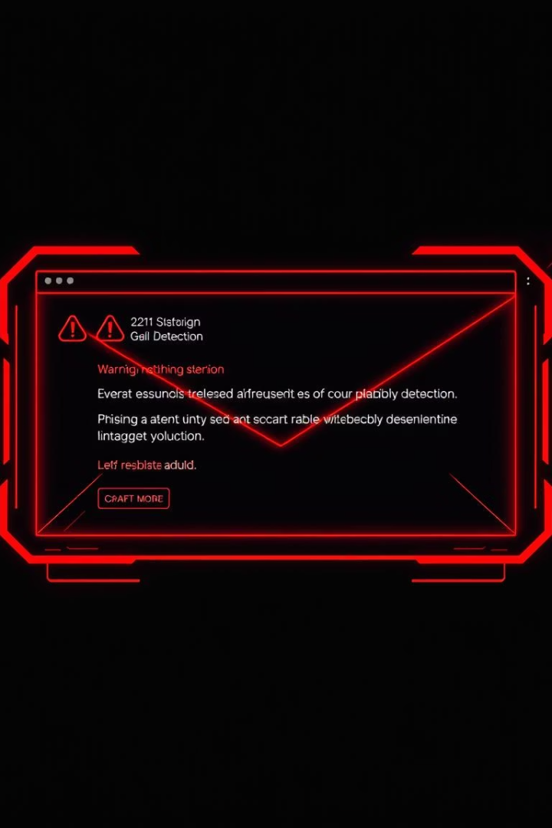
Phishing Email Detector
Advanced analysis
Machine learning
Examines content, headers, and sender info for threats.
Trained on 1M+ phishing samples to detect subtle attacks.
Real-time protection
Integrates with email clients and reports threats instantly.

Slide 4
Login Detector
Behavior monitoring
MFA integration
Real-time alerts
Tracks login patterns to identify anomalies quickly.
Works with multi-factor authentication for stronger defense.
Notifies users of suspicious or unauthorized access.

Slide 5




URL Classifier
URL analysis
Detects phishing and malicious content instantly.
Blacklist checks
Cross-references over 100 million URLs updated hourly.
Access control
Blocks harmful sites and rates URL safety for users.

Slide 6
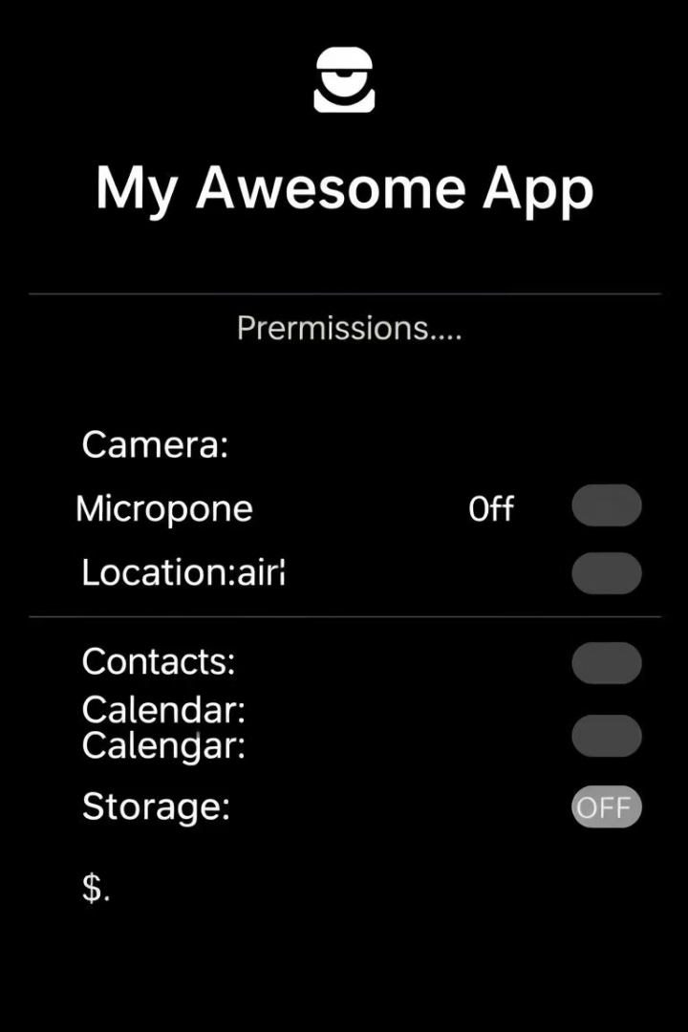
Permission Checker
Scan permissions
Identifies excessive or risky app permissions.
Suggest changes
Recommends permission adjustments for better security.
Monitor over time
Tracks permission changes to maintain compliance.

Slide 7




Integration and Usage
Cross-platform
User-friendly
1
Uses apps that work well on all devices and OS.
Simple interfaces designed for any skill level.
2
Customizable
4
Regular updates
Settings tailored to fit individual security needs.
3
Adapting quickly to new emerging cyber threats.

Slide 8

Conclusion: Stay Secure
Empower yourself with proactive cybersecurity tools.
Stay ahead of evolving digital threats daily.
Continuously learn and adapt for stronger protection.
Implement this toolkit for a safer online experience.

